Slide 1

Plant Disease Diagnose System
Abdul Muhaimin FA21-BSE-061
Asad Khan FA21-BSE-081
Furqan Ahmad FA21-BSE-089
Sir Javed Raza
Department of Computer Science
COMSATS University Islamabad, Abbottabad

Slide 2
Agenda
Project Introduction
Project Scope
Functional Requirements
Non-Functional Requirements
Class Diagram
E-R Diagram
DFD (Structural Approach)
Use Case Diagram
System Block Diagram
Summary of 30% Project Implementation
Gantt Chart

Slide 3
Project Introduction
Smart application for detecting and diagnosing plant diseases
Uses deep learning and image processing techniques
Supports monitoring of multiple plants
Provides detailed disease information and treatment recommendations
Aims to improve plant health management for farmers and agriculturists

Slide 4
Project Scope
Enables disease prediction through plant image uploads (leaf, stem, fruit).
Supports user roles: farmers and admins.
Offers disease reports and recommendations.
Offers a app platform and an offline-supported mobile app.
Accessible in two languages(English and Urdu).

Slide 5
Functional Requirements
User Authentication & Profile Management
Signup/login functionality.
Role-based access control (farmers, experts, admins).
Disease Prediction via Image Upload
Preprocessing and prediction of diseases using a deep learning model.
Plant Health Monitoring
Track multiple plants and their health over time.
Disease Information & Recommendations
A database of plant diseases with treatments and prevention measures.

Slide 6
Non-Functional Requirements
Performance:
The system should deliver accurate results within seconds of image upload.
Usability:
A user-friendly interface, accessible to users of varying technical expertise.
Scalability:
Capable of handling a growing number of users and a large disease database.
Reliability:
Ensure system uptime for critical agricultural operations.
Security:
Protect user data and ensure secure image uploads.

Slide 7
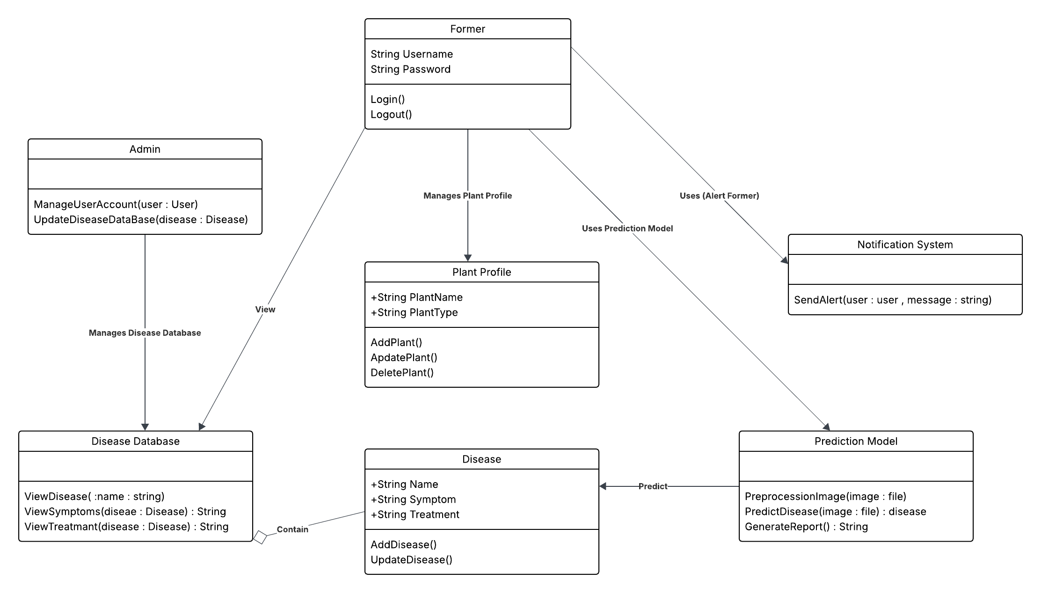
Class Diagram

Slide 8
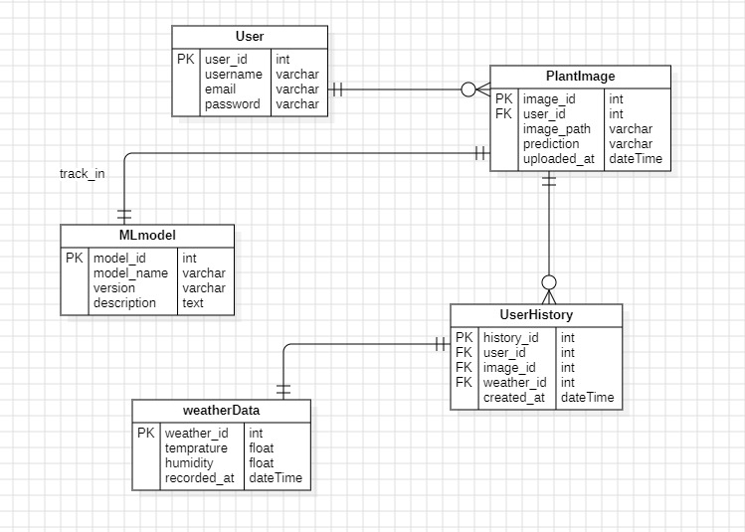
E-R Diagram

Slide 9
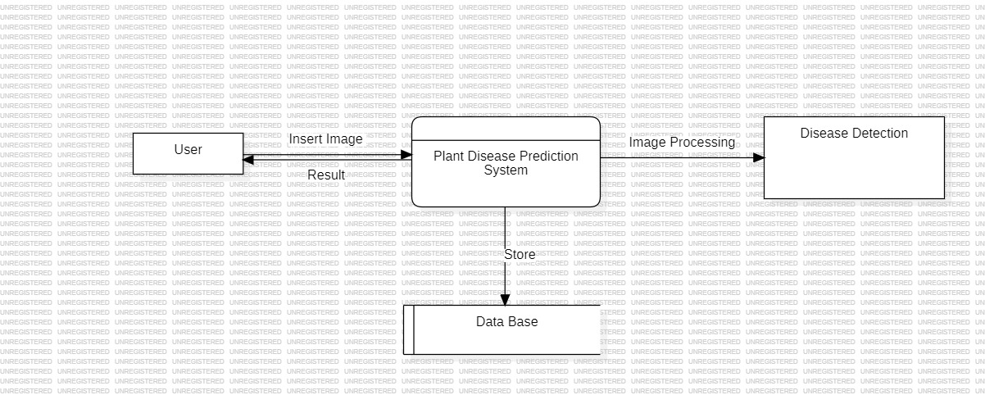
DFD (Structural Approach)

Slide 10
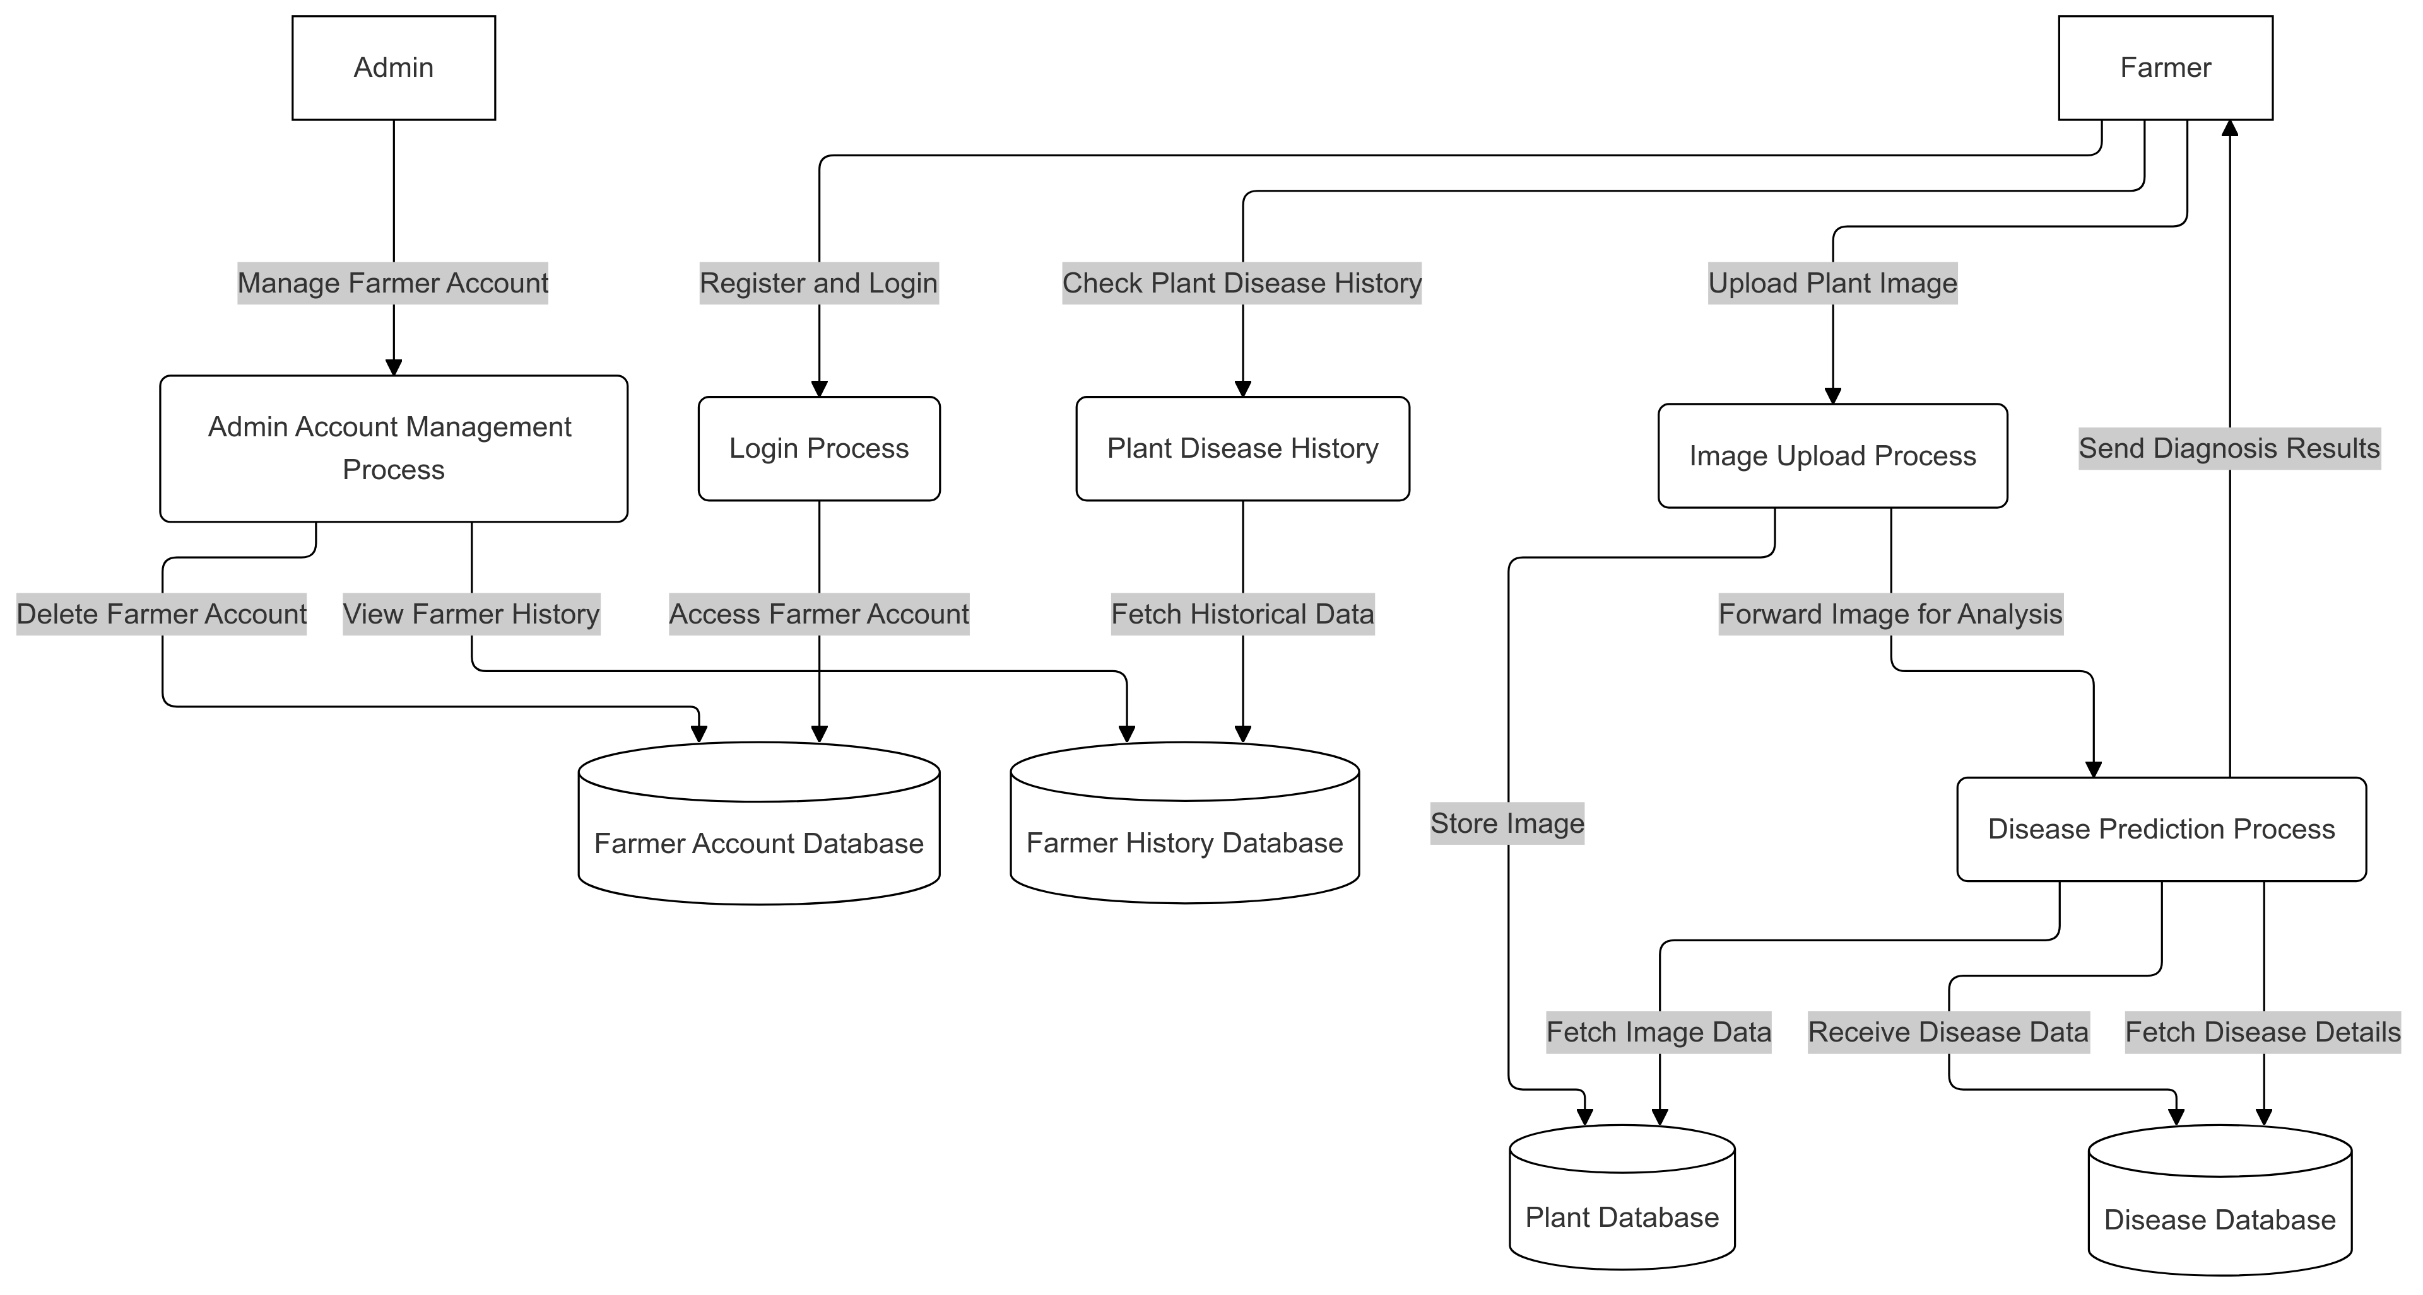
Continue

Slide 11
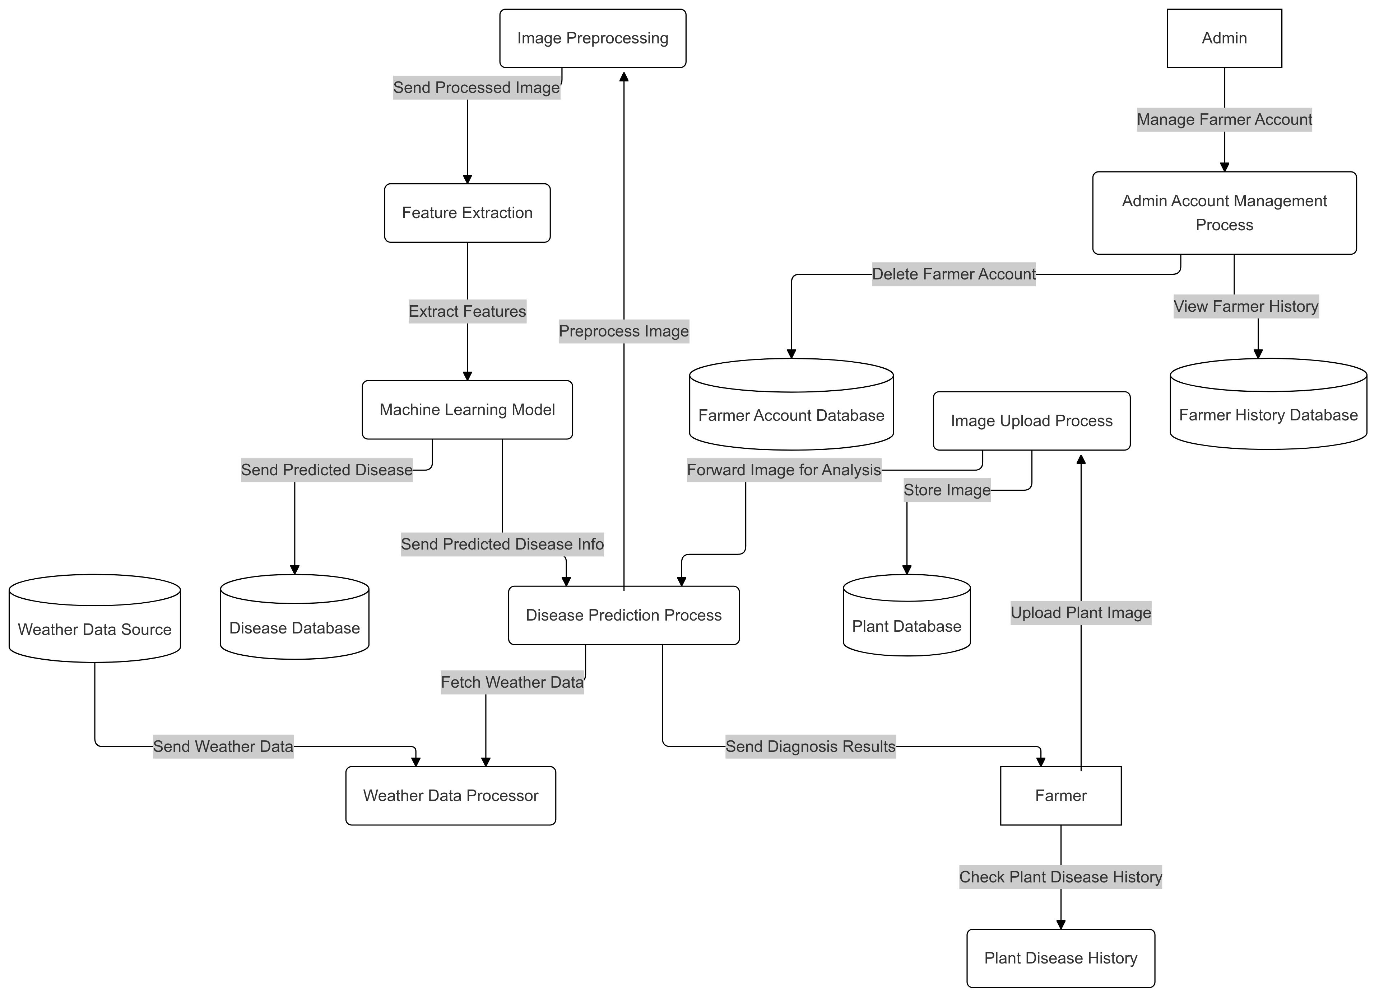
Continue

Slide 12
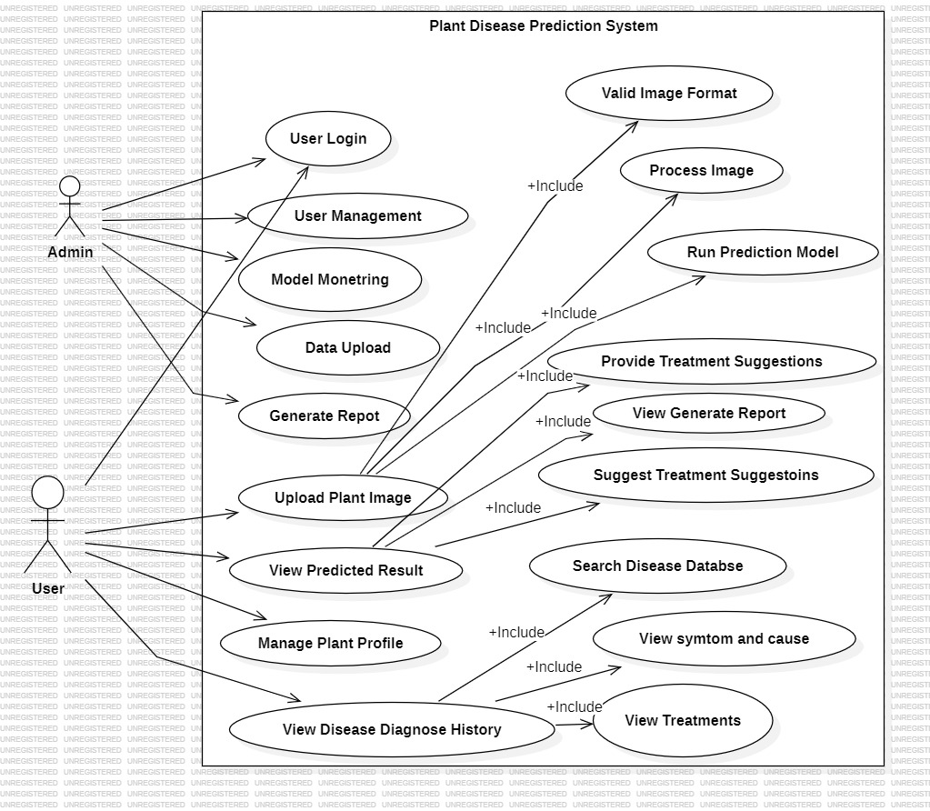
Use Cases Diagram

Slide 13
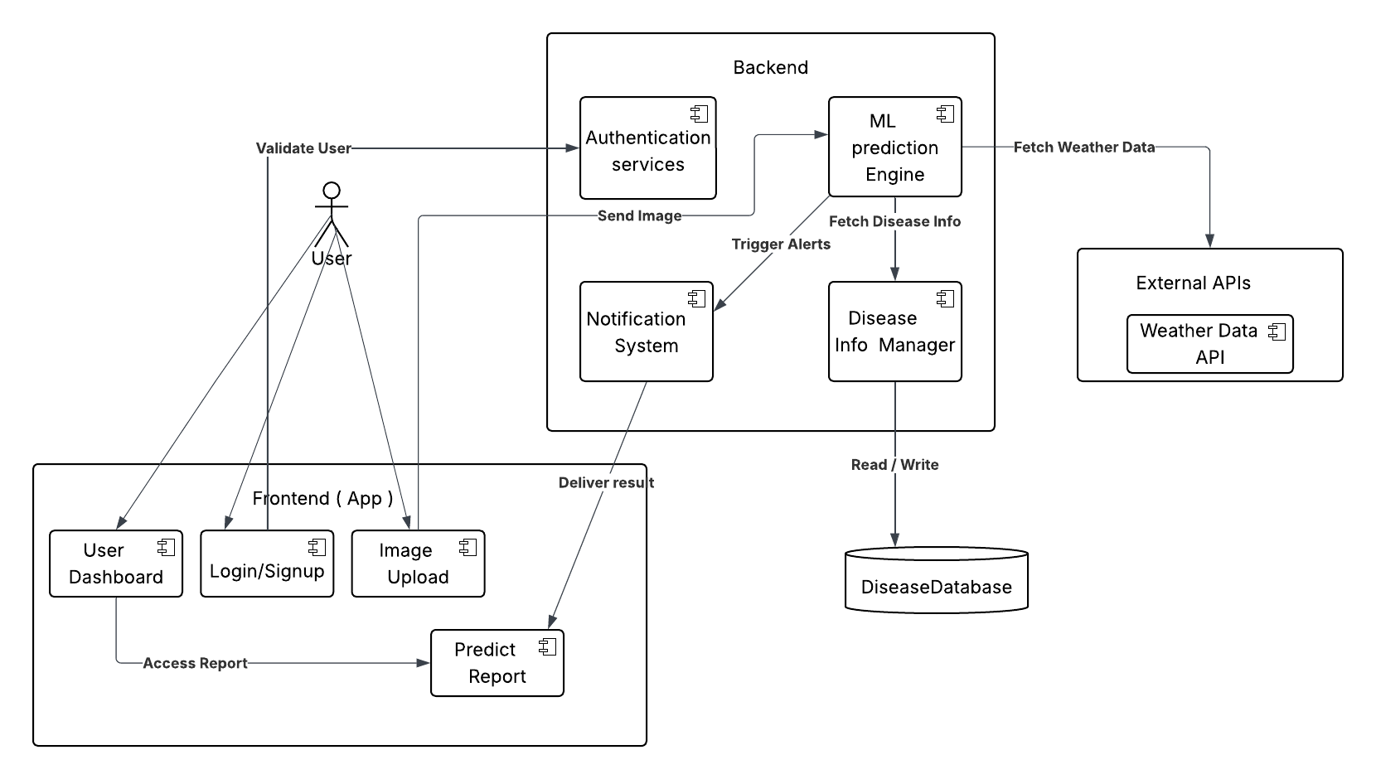
System Block Diagram

Slide 14
Summary of 30% Project Implementation
Requirements gathering
Complete UI (user Interface)
Model Selection

Slide 15
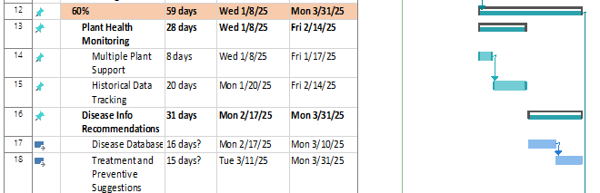
Gantt Chart

